Slide 1

Building A Computer
Snehan Gorain
TEJ1OP
MR Buffone

Slide 2
Table of Contents
Motherboard
Case
CPU
Video Card
Hard Drive Disk
RAM
Blu-Ray Drive
Monitor
Sound Card
Power Supply
Mouse
Keyboard
Speakers
Operating System
Receipt

Slide 3
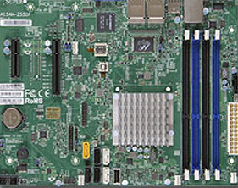
Motherboard
The motherboard is the main circuit board in a computer. It is also known as the main board or the logic board. It allows all the different parts of the computer to work together. The CPU, ROM, memory RAM expansion slots, PCI slots and USB ports are all attached to the motherboard.
Supermicro's motherboards based on Intel® Atom™ processor C2000 series System-on-Chip (formerly Avoton & Rangeley) are well-suited for entry-level server platforms and embedded IPC market.
$397.76
http://www.ncix.com/detail/supermicro-a1srm-2758f-atom-c2758-64gb-53-99429.htm

Slide 4
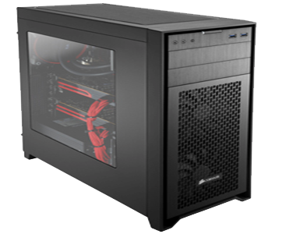
Case
The computer case is the outer shell of a computer. It contains most of the components of a computer and keeps them together, such as the power supply, motherboard, memory, disk drives and other peripheral control units.
Obsidian Series 450D has an elegant brushed aluminum front panel and a solid steel body, with an interior that's optimized for efficient, high-volume airflow. The included dual front AF140L intake fans provide direct GPU cooling.
129.99
http://www.ncix.com/detail/corsair-obsidian-450d-atx-black-55-95571.htm

Slide 5
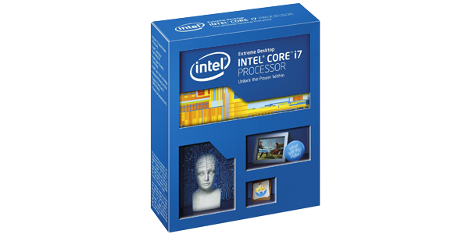
Central Processing Unit (CPU)
The CPU is the primary component of the computer where all the instructions are processed. It runs the operating system and applications, continuously processing input from the user or active software programs. It processes the data and produces the output.
With previous generation Intel® Core™ i7 processors access multiple applications faster and unleash incredible digital media creation. Experience great performance for everything you do with the combination of Intel® Turbo Boost Technology and Intel® Hyper-Threading Technology
$629.99
http://www.ncix.com/detail/intel-core-i7-5930k-3-70ghz-six-db-100098-1246.htm

Slide 6
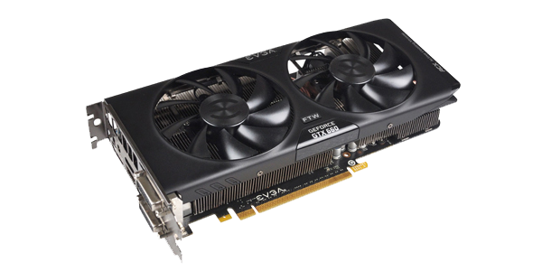
Video Card
A graphics card, or a video card is used to process the graphics portion of data and generate output for the systems display display. It is much like how the CPU (Central Processing Unit) processes all other data.
This graphics card takes NVIDIA Kepler-powered graphics cards to new levels of affordability while retaining class-leading performance and power efficiency, making it a must-have upgrade for today's hottest games. The EVGA GeForce GTX 660 graphics card represents the Kepler "sweet spot" for gamers.
$239.99
http://www.ncix.com/detail/evga-geforce-gtx-660-ftw-68-91929.htm

Slide 7
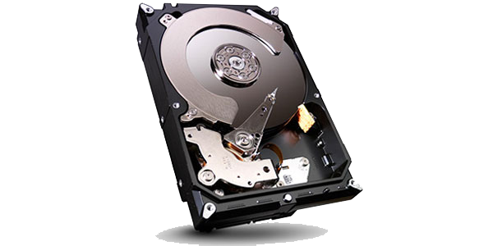
Hard drive Disk
The hard drive disk is the most common storage device used to store data. Hard drive disks are non-volatile, meaning they do not need electricity to be able to store data. It uses a series of spinning platters or magnetic disks which records data in individual bits.
Build desktop or all-in-one PCs Equip home servers, create PC-based gaming systems,
implement a desktop RAID, outfit direct attached external storage devices (DAS), and build network attached storage devices (NAS)
$169.99
http://www.ncix.com/detail/seagate-barracuda-4tb-5900rpm-sata3-e9-80438-1246.htm

Slide 8
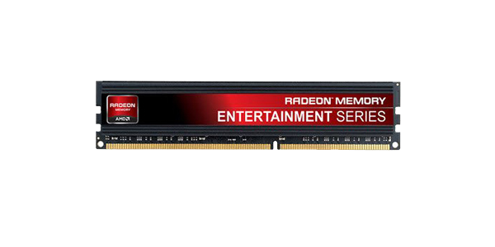
Random Access Memory (RAM)
The RAM is where the operating system, application programs and all data in current use is stored so it can be quickly and efficiently reached by the CPU. It is made of small memory chips that form memory modules which are stored in slots in the mother board. Whenever a program is opened, it gets loaded from the Hard Drive Disk into the ram. This is done because reading data from the RAM is much quicker than reading data from the Hard Drive Disk making it more time efficient.
The low-profile heat spreader provides additional protection with the added assurance of high compatibility testing, backed by a lifetime warranty. Running frequencies up to 1600MHz and programmed with JEDEC timings.
$179.99
http://www.ncix.com/detail/amd-radeon-entertainment-edition-16gb-87-78218.htm

Slide 9
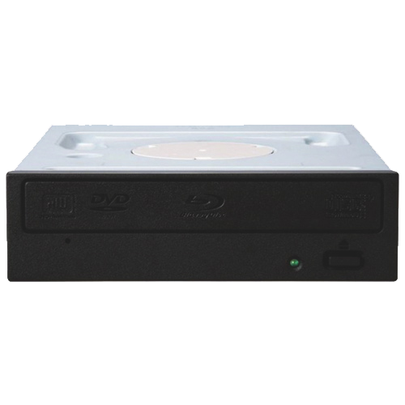
Blu-Ray Drive
A Blu-ray drive is a device used to read Blu-ray disks. Blu-ray is an optical disk format such as CD or DVD. They are designed for recording and playing back high definition video and for storing large amounts of data.
This internal SATA drive can read up to 8x with BD-R (25GB) and BD-R dual layer (50GB) media. It's also backwards compatible, so it can read and write to most DVD and CD formats.
$59.99
http://www.futureshop.ca/en-CA/product/pioneer-pioneer-8x-blu-ray-combo-drive-bdc-207dbk-bdc-207dbk/10218162.aspx?path=2d7763a2d4aa99db11c3ecd6bcab2e64en02

Slide 10
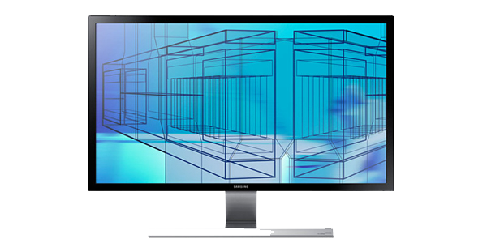
Monitor
A monitor is used to display the computers user interface. It allows the computer to communicate with the user and displays the output to the user.
The Samsung UHD monitor offers a resolution 4 times higher than Full HD and an incredible 1 billion colors bring images to life with unparalleled realism. A superfast 1-millisecond response time handles even the fastest moving scenes in movies and games, and great connectivity.
$549.99
http://www.ncix.com/detail/samsung-u28d590d-28in-4k-uhd-c5-95635-1246.htm

Slide 11
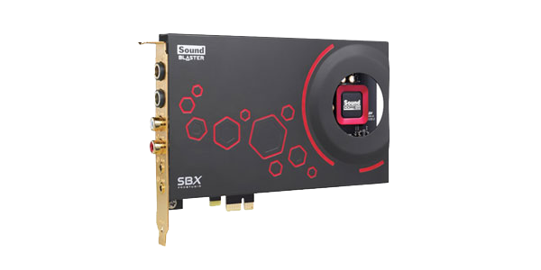
Sound Card
A sound card is a component inside the computer that provides audio input and output capabilities. Most sound cards have at least one analog line input and one stereo line output connection.
The Sound Blaster ZxR is the flagship of the ultra high-performance Z-Series of Sound Blaster® Sound Blaster ZxR personifies the ultimate gaming and entertainment performance for a sound card.
$249.99
http://www.ncix.com/detail/creative-soundblaster-zxr-pcie-sound-4c-81293.htm

Slide 12
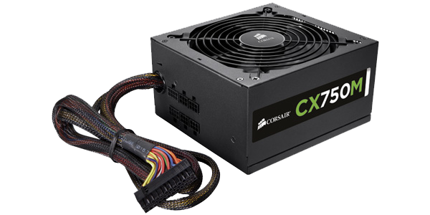
Power Supply
A power supply is a hardware component that provides power to an electrical device. It receives power from an electrical outlet and converts the current from AC (Alternating Current) to DC (Direct Current) which the computer utilizes. It regulates the voltage which allows the computer to run smoothly without overheating.
The flexible modular cabling system lets you use only the cables you need, and 80 PLUS Bronze certified efficiency means less excess heat, lower noise, and lower power bills. The large diameter reduces noise even when you're pushing your system hard.
$89.99
http://www.ncix.com/detail/corsair-cx-series-cx750m-750w-f2-78574-1246.htm

Slide 13
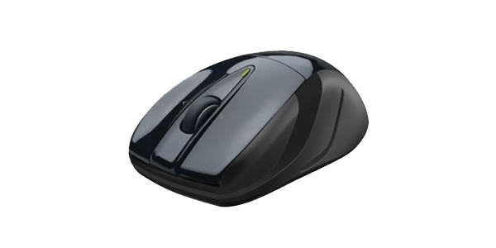
Mouse
The mouse is one of the primary input devices used for a computer. It consists of at least on button which is used to select items on a screen. Most mice also have a scroll-wheel which is used to scroll up and down documents and web pages.
Our innovative micro-precise wheel packs more grooves per millimeter giving, you the ultimate navigation experience.
It is built for hands like yours with its ergonomically shaped design and soft rubber grips, this mouse is built for comfort.
$17.99
http://www.ncix.com/detail/logitech-m525-wireless-mouse-ergonomic-f8-91859-1246.htm

Slide 14
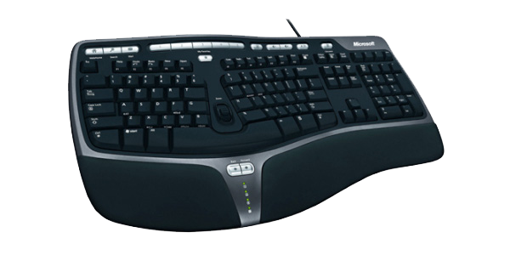
Keyboard
The keyboard, as well as the mouse is on of the primary input devices used for a computer. It is a board with keys which is used to type words on the screen and enter commands.
Rest your wrists against the plush palm rest in a relaxed, natural angle with this keyboard’s curved key bed, ergonomic arc, and reversed slope. Apart from comfort and support, enjoy quick, customizable way to reach files, folders, and web pages with handy hot keys.
$38.99
http://www.ncix.com/detail/microsoft-natural-ergonomic-4000-keyboard-65-34942-1608.htm

Slide 15
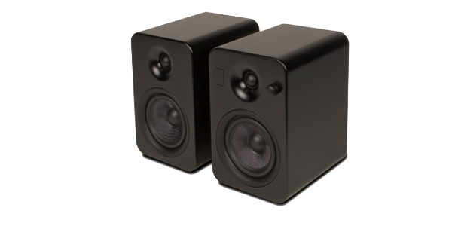
Speakers
Speakers are used to output audio from a sound system which can be heard by the listener.. Some speakers are used specifically for a computer, while others can be connected to almost any sound system.
These book shelf peakers include BluetoothTM wireless, RCA analog, a 3.5mm stereo jack, and two TOSLINK optical audio inputs. Two USB power outputs let you charge your devices while you listen, and after as well. And we added a sub- woofer output so you can really extend the audio range of this great system.
$249.99
http://www.ncix.com/detail/kanto-yumi-powered-bookshelf-speakers-8c-92663-1735.htm

Slide 16
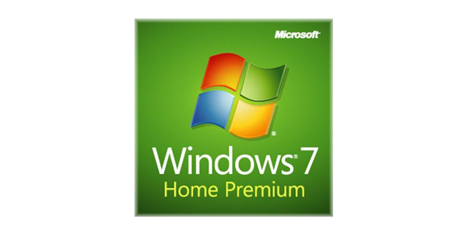
Operating System (OS)
The Operating System is a software that communicated to the hardware and allows other programs to run. It provides basic functionality for devices such as computers, tablets and smartphones. Common operating systems include Mac OS X, Linux, Unix and windows.
Windows 7 Home Premium offers the best entertainment experience on your PC. With fewer clicks, faster searching, easier browsing, and simpler ways to connect, there's less between you and what you want to do.
$107.99
http://www.ncix.com/detail/microsoft-windows-7-home-premium-c0-45271-1246.htm

Slide 17
The Receipt
Product | Price
Motherboard | $397.76
Case | $129.99
CPU | $629.99
Video Card | $239.99
Hard Drive Disk | $169.99
RAM | $179.99
Blu-Ray Drive | $59.99
Monitor | $549.99
Sound Card | $249.99
Power Supply | $89.99
Mouse | $17.99
Keyboard | $38.99
Speakers | $249.99

Slide 18
Receipt (Cont.)
Product | Cost
Operating System | $107.99
Total | $3112.63

